Slide 1
PHOTO EDITING - Technical Design
CSE 611 – MS Project Development
Professor – Jinjun Xiong

Slide 2
TEAM MEMBERS
Pavana Lakshmi Venugopal
Saad Ahmed
Taraka Rohit Adusumilli
Ayesha Humaera

Slide 3
Tech Stack
Front End:
Back End:
Stack | Functionality
React Js | Create UI Interface
HTML & CSS | Build UI framework and Styling
JavaScript | Dynamic content update
Stack | Functionality
Python | Develop backend
Django REST API | Create and manage REST APIs
‹#›

Slide 4
Data Sources
The primary data source is the input image provided by the user which needs to be edited.
Input images will not be stored anywhere.
A single relation will be employed to record user activity with various features of the application, as follows
Data will be deleted after 24 hours.
ID | Features | Count
‹#›

Slide 5
MVC Architecture
MVC stands for Model-View-Controller. The MVC model is based on the idea of separating the application into three interconnected components.
Model:
The Model component represents the application data and business logic.
Managing Data (Create, Update, Delete)
Preprocessing User Input
Perform Necessary Calculations.
View:
The View Component is responsible for rendering the data from the model in a way i.e appropriate to the user . and also provides user interface and interacts with the user.
Notes:
‹#›

Slide 6
MVC Architecture
Controller:
Managing the user input
Updates Model and View components as necessary.
It simply acts as the intermediary between the model and view and handles requests, interpreting them and updating necessary components.
Notes:
‹#›

Slide 7
MVC Workflow
The user interacts with the application's user interface, such as clicking a button or uploading an image, to initiate a request.
This request is then received by the MVC controller, which is responsible for managing and processing user input. The controller analyzes the user's request and determines the appropriate course of action, including fetching any necessary information from the model.
The model updates or extracts data from the feature count database.
After input parameters are validated the request goes to the application controllers, where validation specific to the features takes place, and request is forwarded to the appropriate features.
The user’s browser receives the response from the application and display the updated view.
Notes:
‹#›

Slide 8
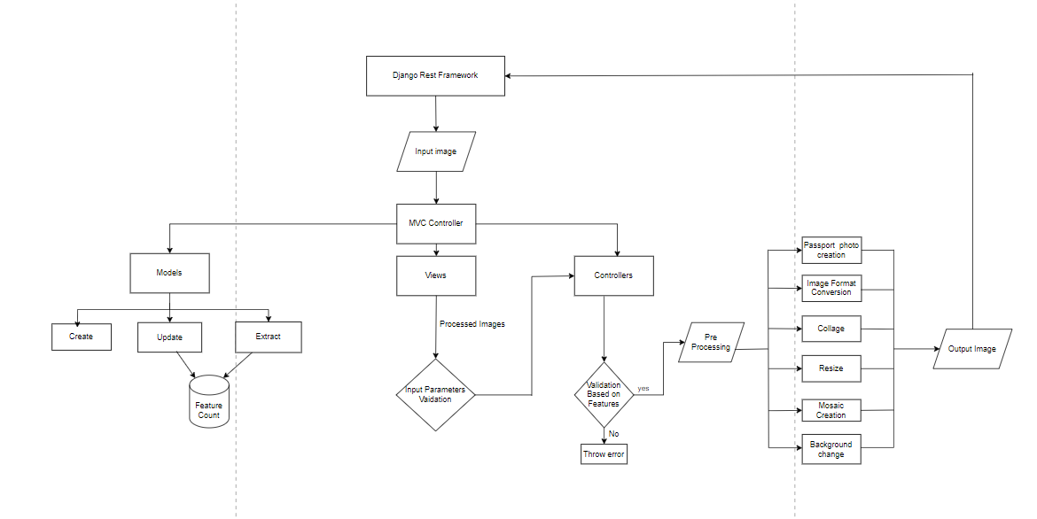
Technical Architecture
‹#›

Slide 9
Technical Design Diagram Components
Request Management:
Routing Mechanism: Efficiently matches incoming requests to appropriate responses.
Endpoints: Bridges the user interface with our underlying core logic.
Image Manipulation:
OpenCV Integration: Utilized for a range of image processing tasks including, but not limited to, image resizing, cropping, and facial detection.
‹#›

Slide 10
Design Specifications
Input/Output:
Uploads: Accepts formats .jpg and .png for images from user devices.
Downloads: Enables users to retrieve their edited images.
‹#›

Slide 11
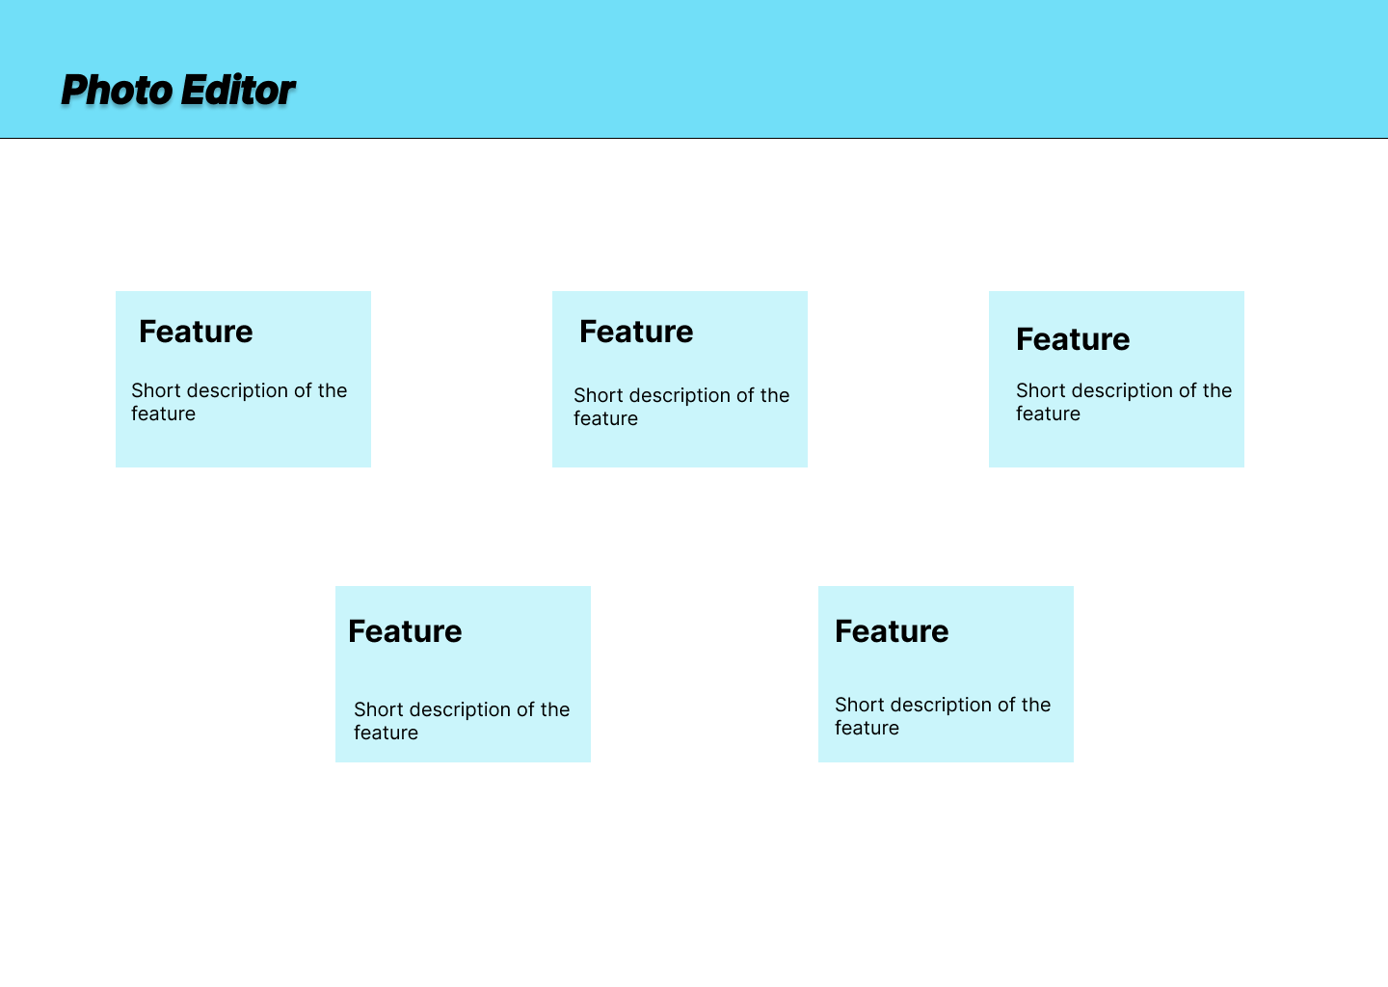
Wireframe
‹#›

Slide 12
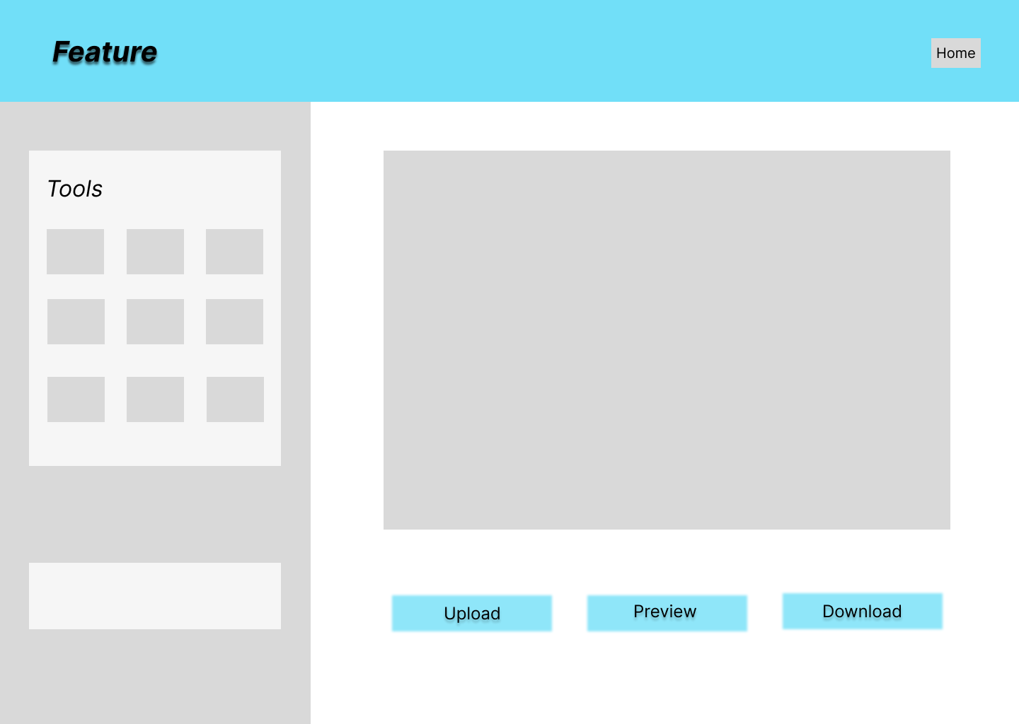
Wireframe
‹#›

Slide 13
Wireframe Review & Direction
Wireframe Overview
Presents a skeletal visualization of our User Interface (UI).
Previously shown wireframes showcase the layout for both the home page and feature pages of our Photo Editor.
Main Page Highlights
a. Feature Cards
Multiple cards detailing each feature.
Each card is accompanied by a concise explanation of its functionality.
b. Navigation & Flow
Clicking on any feature card leads to its respective feature page.
Intuitive layout ensures easy user navigation.
Notes:
‹#›

Slide 14
Wireframe Review & Direction
Feature Page Layout
a. Options Panel
Positioned to the left.
Contains specific controls related to the chosen feature.
b. Image Interaction
Located to the right.
Allows users to upload, preview the edited image, and download it seamlessly.
Direction Forward
Upholding the existing UI design due to its proven effectiveness.
Prioritizing User Experience (UX) enhancements to ensure a smoother and more intuitive journey for our users.
Notes:
‹#›

Slide 15
Sample Passport photo size requirements
The basic passport photograph requirements for some countries are as follows:
The United States: 2” x 2”
Canada: 5cm x 7cm.
Mexico: 2” x 2”.
United Kingdom: 4.5cm x 3.5cm.
Germany: 4.5cm x 3.5cm.
France: 4.5cm x 3.5cm.
Italy: 4.5cm x 3.5cm
Spain: 4cm x 3cm
·Russia: 4.5cm x 3.5cm.
Turkey: 4.5cm x 3.5cm
Netherlands: 4.5cm x 3.5cm.
Australia: 4.5cm x 3.5cm.
China: 4.8cm x 4.3cm
Japan: 4.5cm x 3.5cm
India: 3.5cm x 3.5cm
Singapore: 4.5cm x 3.5cm.Korea: 4.5cm x3.5cm
Brazil: 7cm x 5cm.
Notes:
‹#›

Slide 16
Expanding Passport Photo Feature Support
Relevance: Expanding support to these countries enhances our application's reach, catering to users from frequent travel destinations.
Accuracy: Passport photo requirements can vary even within a country based on visa or application type.
User Caution: Always emphasize users to refer to official guidelines. Consider providing links or guiding them to official sources.
Updates: Consider regular updates as countries' requirements can change, ensuring our tool's continued reliability.
Considering New Countries::
South Africa
Argentina
Thailand
New Zealand
UAE
Malaysia
Indonesia
Vietnam
Chile
Saudi Arabia
Notes:
‹#›

Slide 17
Revised Project Features
Feedback & Iteration:
Based on our discussion last week, we're focusing on streamlined, essential features rather than an extensive suite.
Enhancements :
Mosaic Feature: Needs to be worked for updations and proper functioning.
Our Vision:
Delivering a user-friendly application that fulfills the most common editing needs without overwhelming the user with a plethora of features like other editing tools.
Notes:
‹#›

Slide 18
New Functionalities (Proposed)
Multiple Photo Sizes:
Allow users to edit photos for different document sizes beyond passports, like visas, driver's licenses, and ID cards, with templates and guidelines for each.
This feature caters to a wider audience, including travelers, students, and individuals who need various types of document photos.
Image Compression:
Efficiently reduce file sizes while maintaining image quality.
Video Compression
Optimized to retain resolution while reducing space.
Circle Crop:
Creates a unique and eye-catching visual effect that can make an image stand out.
Automatically eliminates clutter at corners.
Notes:
‹#›

Slide 19
Thank you
Notes:
‹#›

